Slide 1
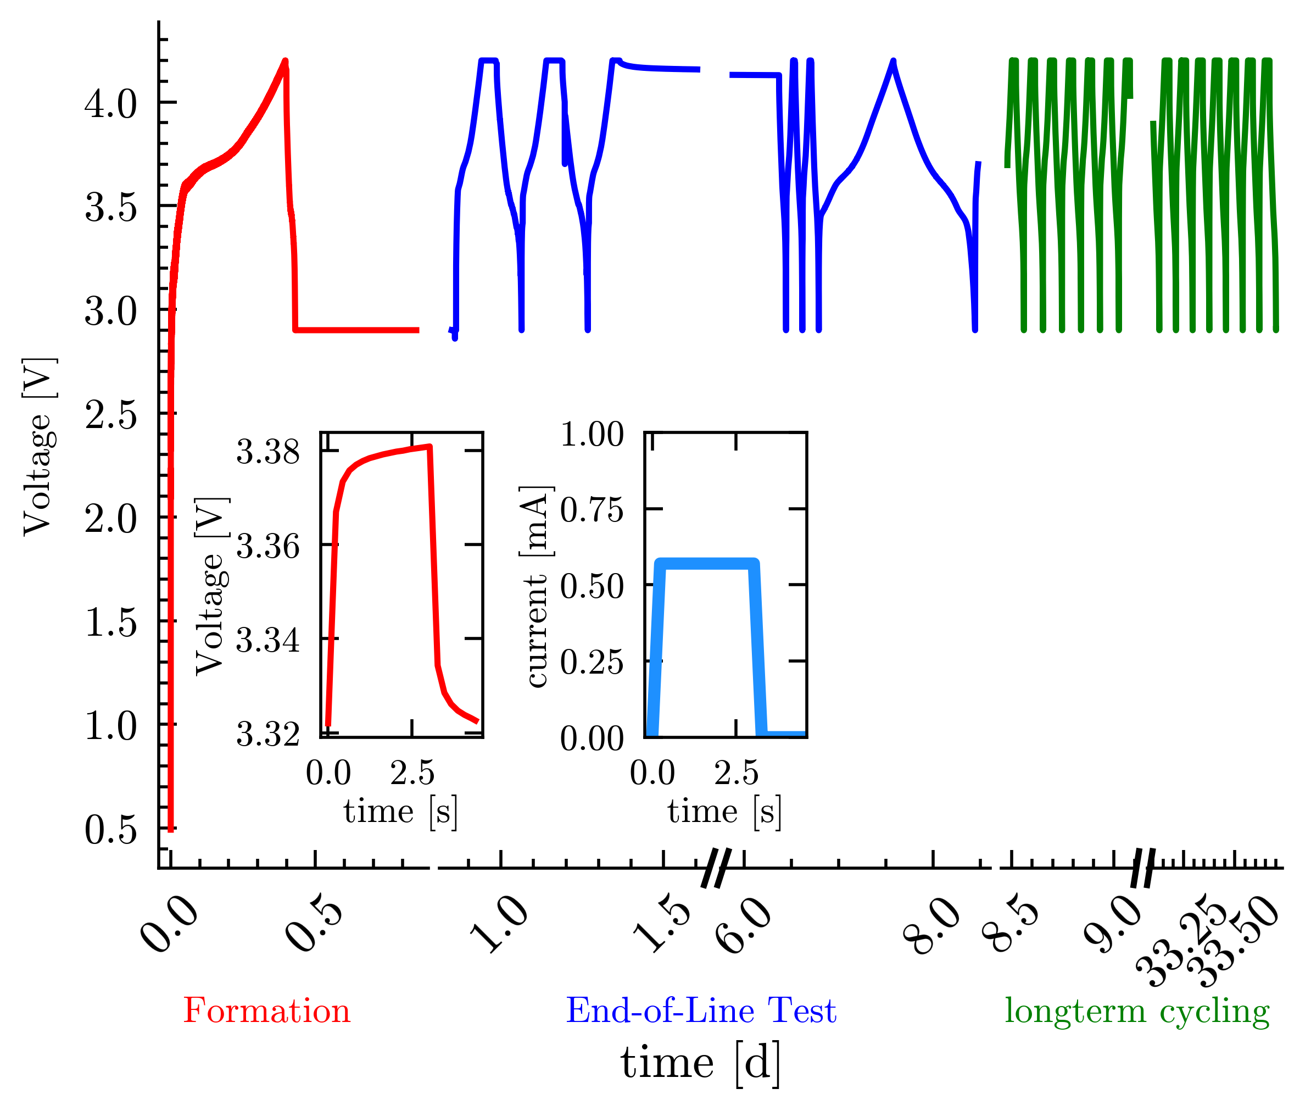
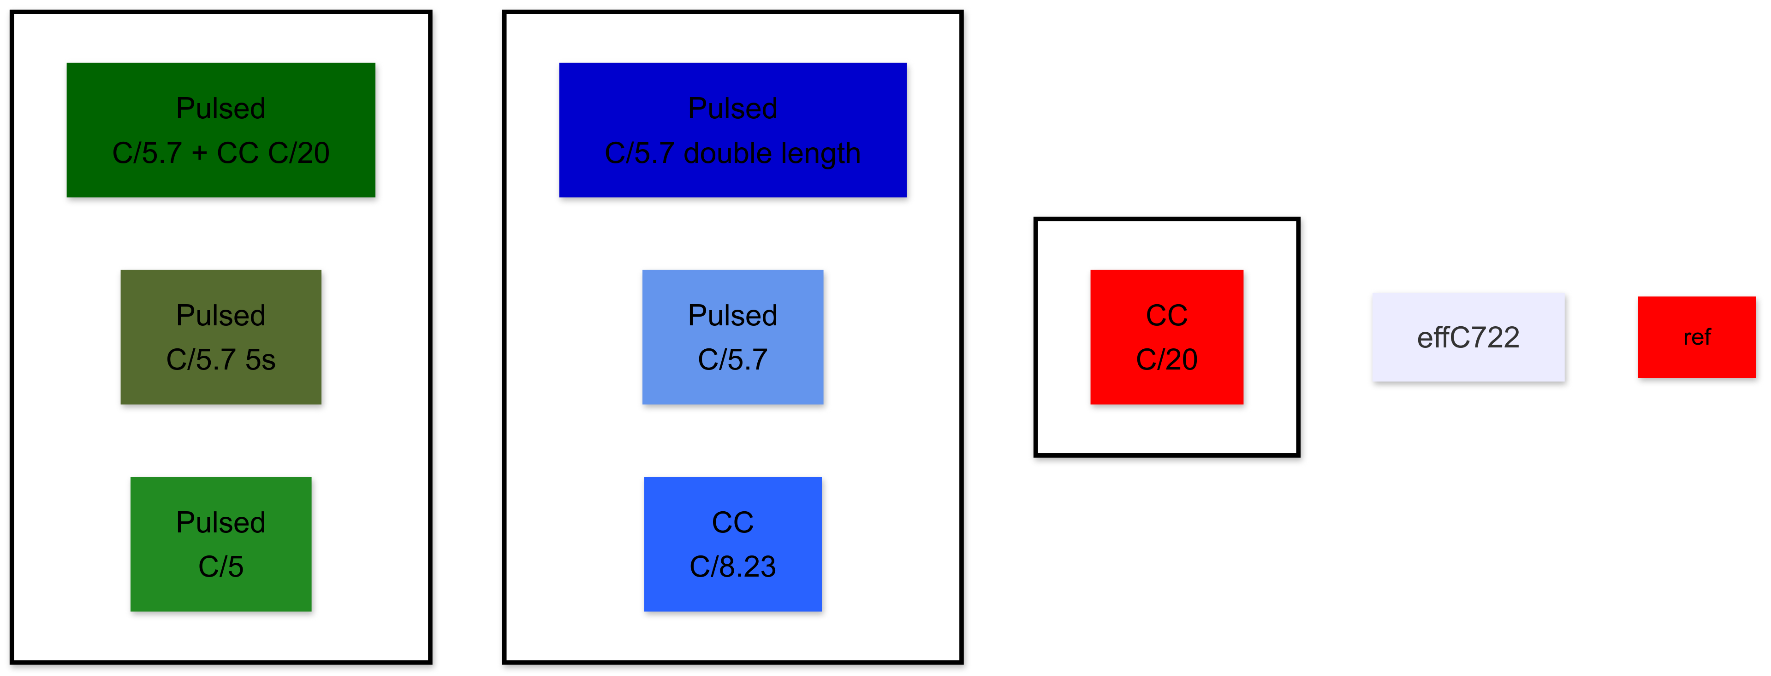
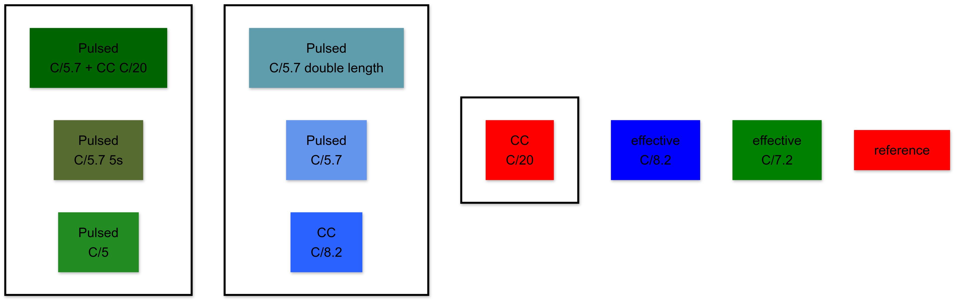
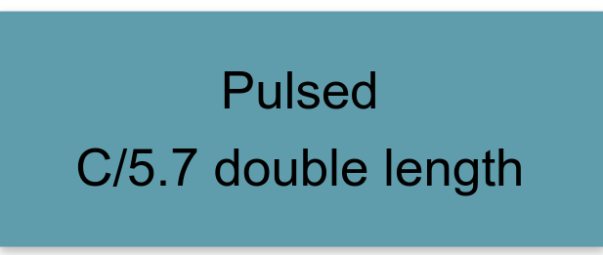
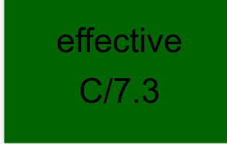
Formation parameter
t_{on} | t_{off} | current | current
const. | 0s | C/20 | C/20
6s | 2,66s | C/5.7 | C/5.7
3s | 1,33s | C/5.7 | C/5.7
const. | 0s | C/8.2 | C/8.23
3s C/5.7 1,33s C/20
5s | 1,33s |  | C/5.7
3s | 1,33s |  | C/5
t_{on}
t_{off}
t_{on}
t_{off}

Slide 2
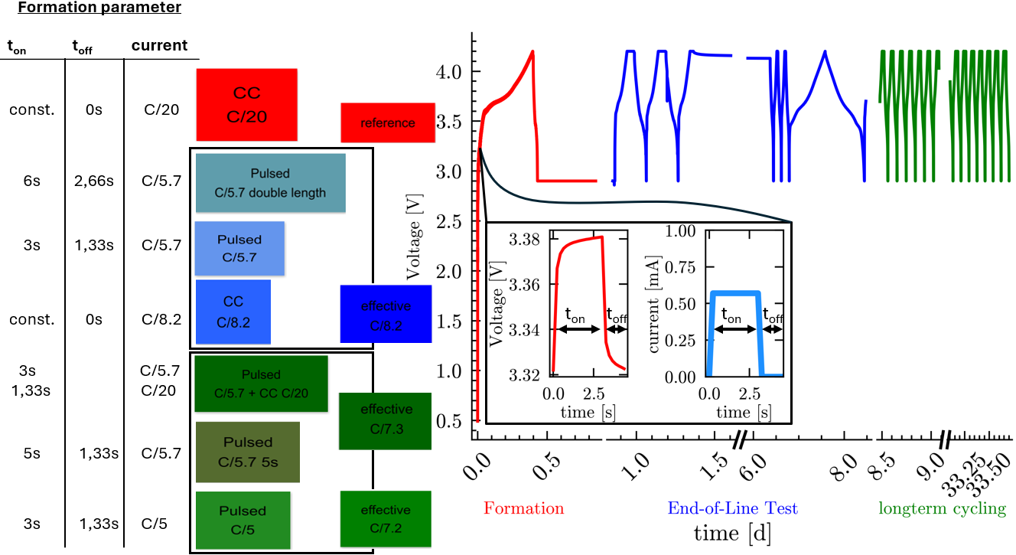

Slide 3
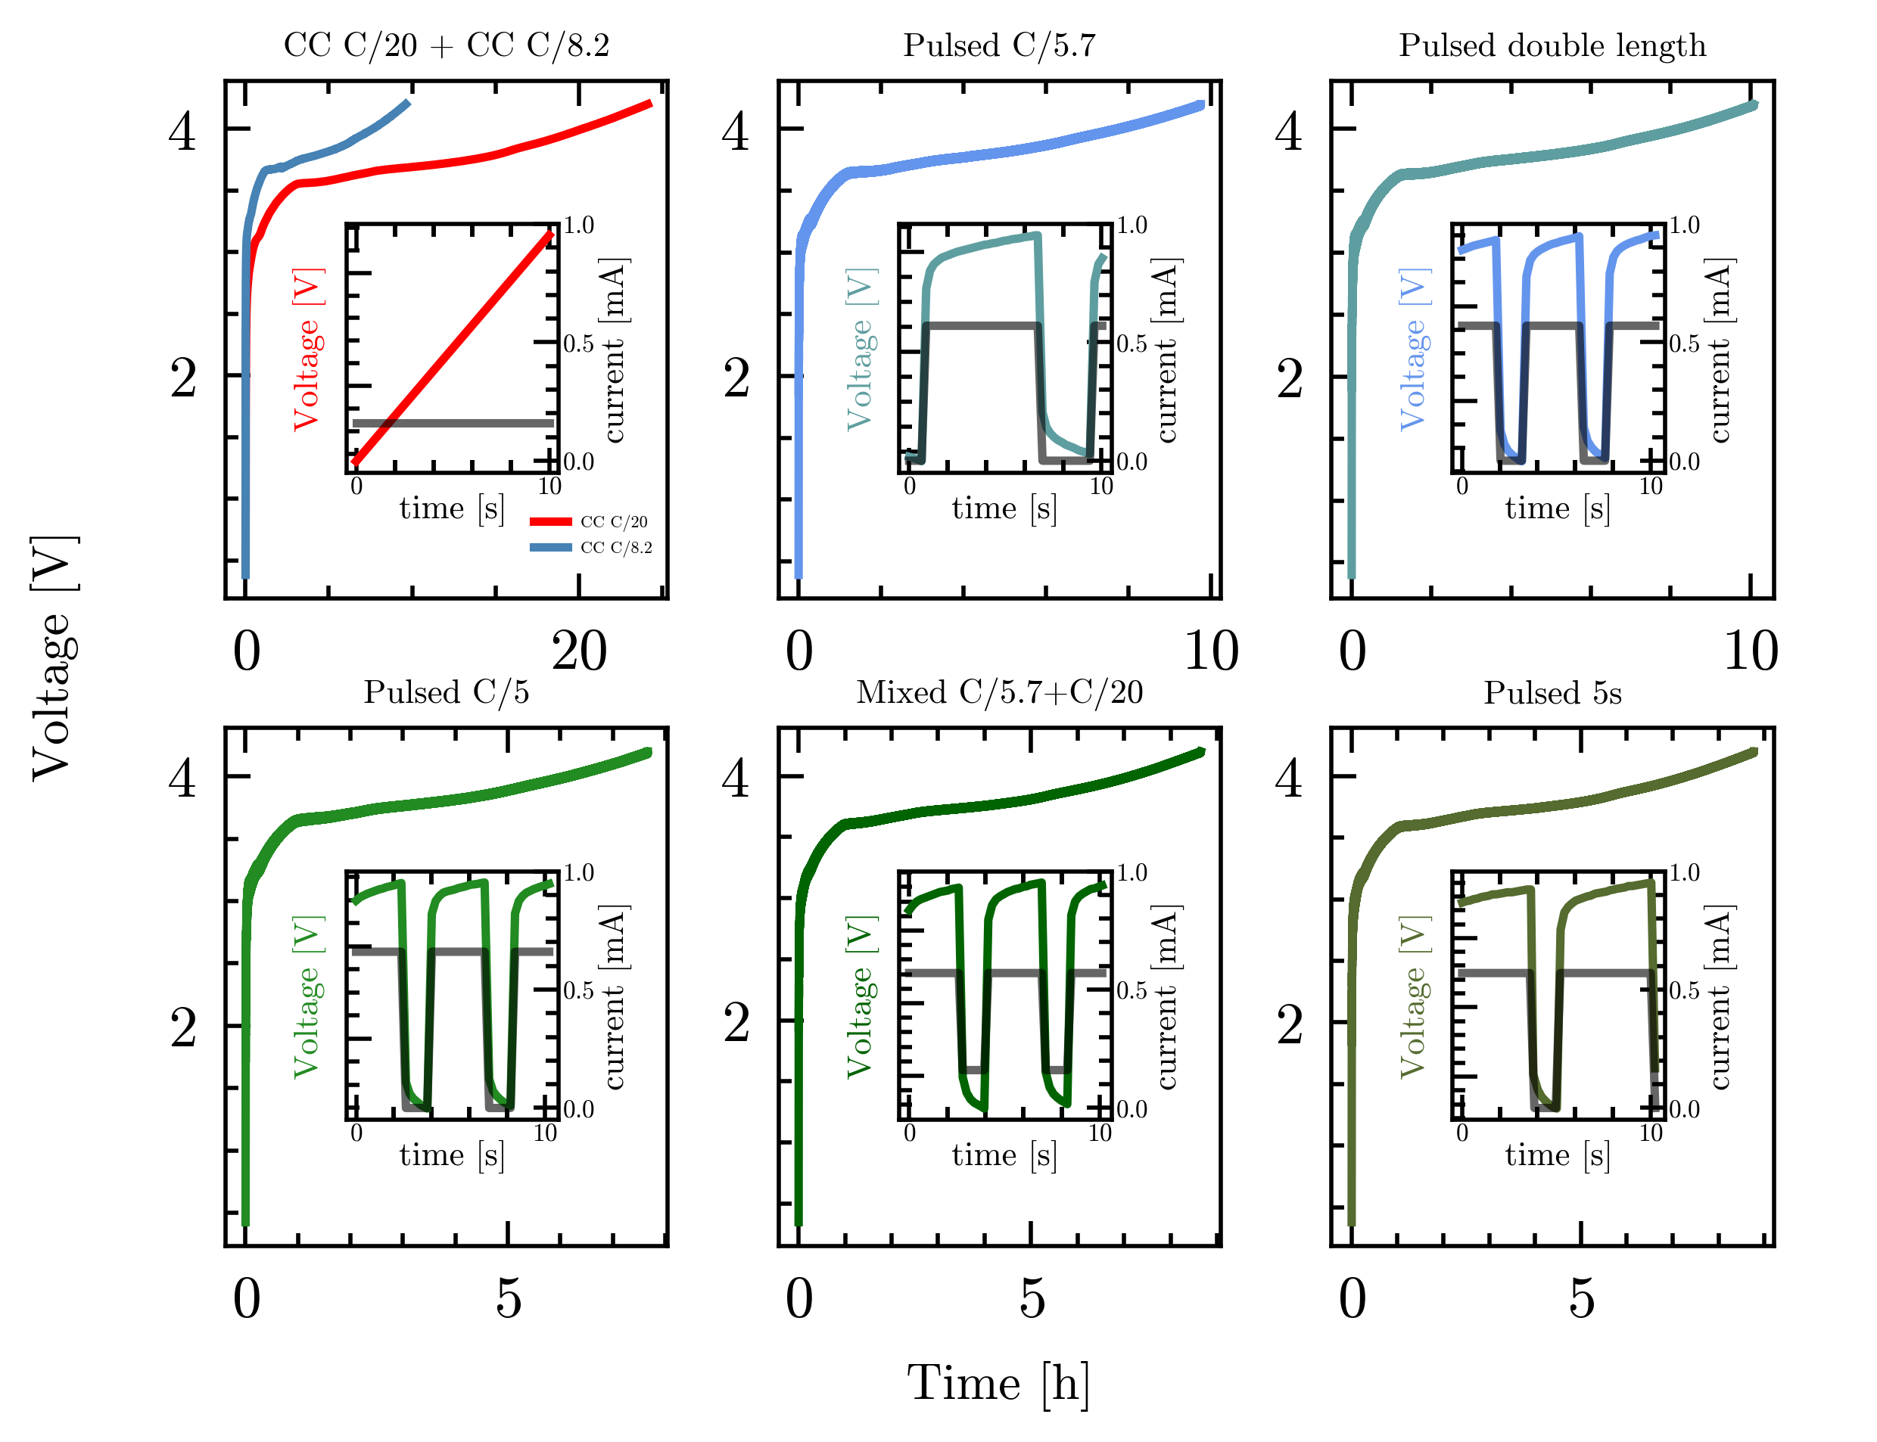
t_{on}
t_{off}
t_{on}
t_{off}
t_{on}
t_{off}
t_{on}
t_{CC20}
t_{on}
t_{off}

